Slide 1
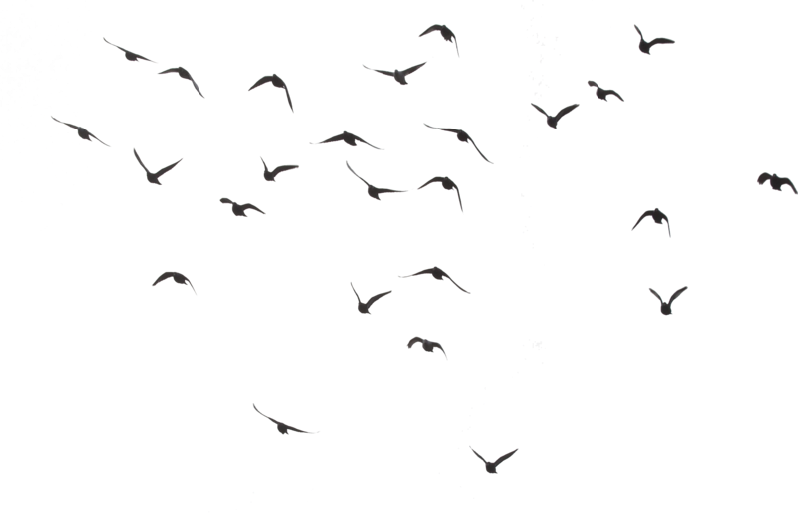
By: Shahriar Sadi

Slide 5
